Slide 1


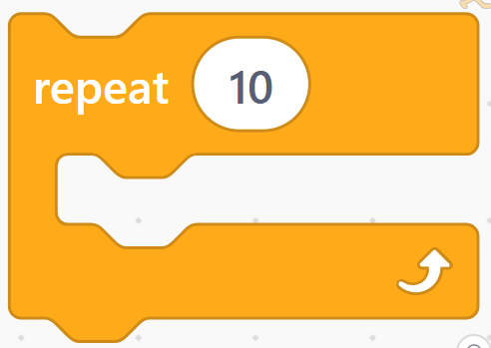
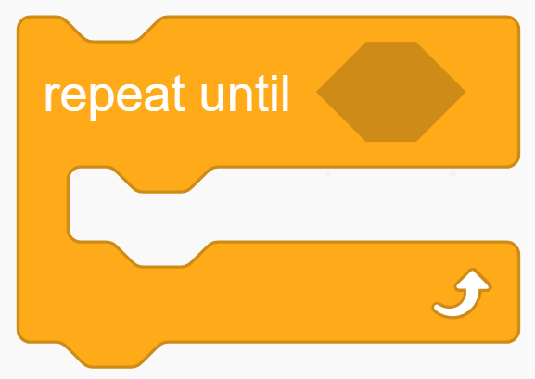

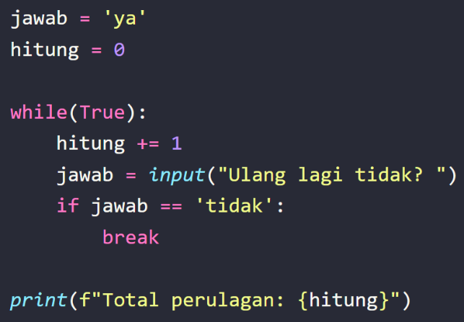
Loop / Perulangan
Praktikum Algoritma dan Pemrograman

Slide 2
Loop /
Perulangan
Praktikum Algoritma dan Pemrograman
Dosen Pengampu :
Rofiq Cahyo Prayogo, S. T, M. T
Fitra Adi Kusuma(40040326630059)
Teknologi Rekayasa Otomasi
Departemen Teknologi Industri
Sekolah Vokasi
Universitas Diponegoro

Slide 3
Alur Pembelajaran
Pengertian Loop/perulangan
Jenis loop
Perbedaan for dan while
Cara menyatakan for
Cara menyatakan while
Perulangan di flowchart
Break dan continu
Pembuatan proyek
Demo program

Slide 4
Loop/Perulangan
Perintah yang dilakukan terus-menerus hingga kondisi tertentu terpenuhi.

Slide 5
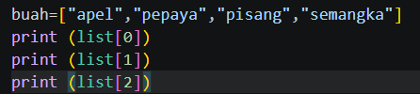

Fungsi loop dalam pemrograman
Perlu tulis berkali kali
Hanya perlu ditulis sekali

Slide 6
Jenis loop
Terdapat dua jenis perulangan dalam bahasa pemrograman python: perulangan for dan while.
for
while
Perulangan yang terhitung dan sudah diketahui banyaknya banyak perulangannya
Perulangan yang tak terhitung dan memiliki syarat dan tidak tentu berapa banyak perulangannya

Slide 7
Perbedaan for dan while
Perulangan FOR | Perulangan While
Digunakan dalam sintaks itu sendiri | Dilakukan sebelum perulangan
Digunakan ketika jumlah perulangan diketahui | Digunakan Ketika jumlah perulangan belum diketahui
Lebih terstruktur | Fleksibel untuk kondisi kompleks

Slide 8

Cara menyatakan for
Pyhton
Scratch

Slide 9
Cara menyatakan while
Pyhton
Scratch

Slide 10
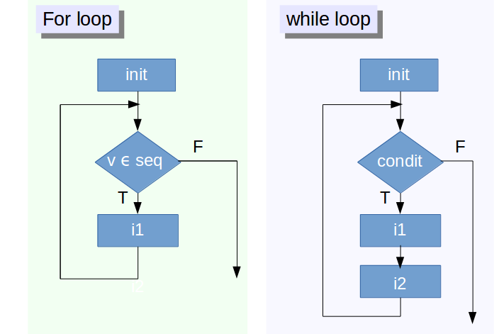
Perulangan di Flowchart
Sumber : https://share.google/rQvWMIgaBwsHfGnET

Slide 11
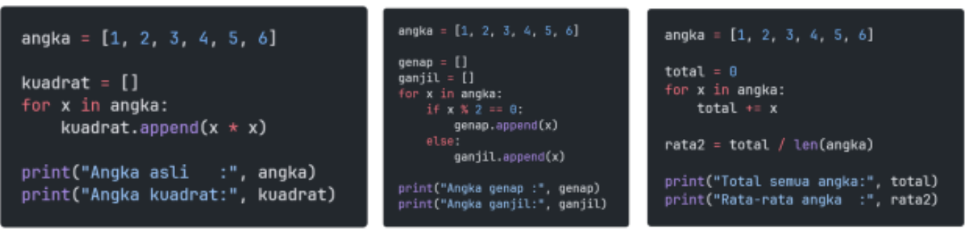
Memebentuk List baru dari list lama menggunakan looping
Mapping
Filtering
Aggreegation

Slide 12
Break dan continu
Digunakan untuk menginterupsi dan juga men-skip suatu iterasi pada perulangan
Break
Continu
untuk interupsi (memberhentikan paksa) sebuah perulangan
untuk menskip ke iterasi selanjutnya

Slide 13

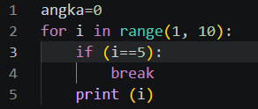
Break
Sistem akan memberhentikan perulangan ketika i==5 dan belum sempat melakukan perintah print()
Input
Output

Slide 14
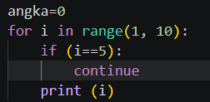
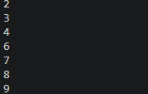
Continue
Pada saat i==5, perintah print(i) tidak dieksekusi dan justru di-skip ke iterasi berikutnya
Input
Output

Slide 15
Project
Membuat pesanan di warung makan indomie :
Disediakan jenis Indomie (Biasa, Aceh, Rendang, Cabe ijo, Ayam bawang)
Pilih jenis Indomie
Apakah ingin pesan Indomie lagi (iya: Kembali ke no 2; tidak: keluar total harga dan tanyakan apakah ingin memberi tip)

Slide 16
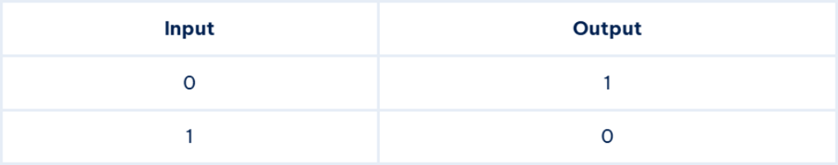
Logika NOT
1 = TRUE
0 = FALSE
Kebalikan nilai Boolean yag diberikan

Slide 17
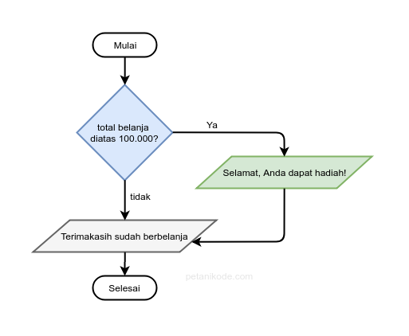
Percabangan IF
Percabangan if digunakan saat terdapat satu pilihan keputusan.

Slide 18
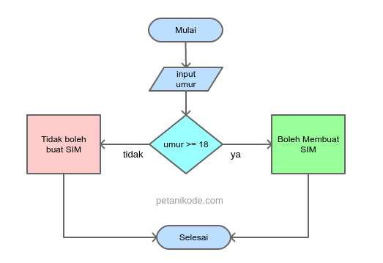
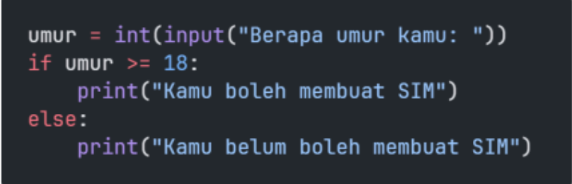
Percabangan IF/ELSE
Percabangan if else digunakan saat terdapat dua pilihan keputusan.

Slide 19
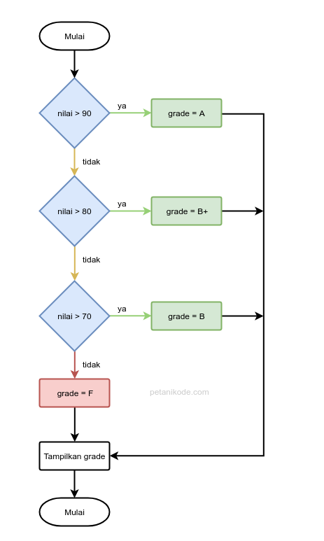
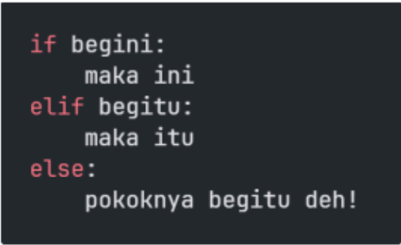
Percabangan IF/ELSE IF/ ELSE
Percabangan if/elif/else digunakan saat terdapat lebih dari dua pilihan keputusan.

Slide 20
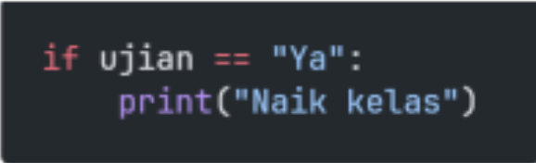
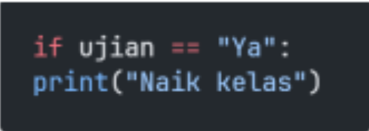
Aturan Penulisan Percabangan
Penulisan yang benar Penulisan blok if harus diberikan indentasi tab atau spasi 2x. | Penulisan yang salah Tanpa indentasi/spasi/tab

Slide 21
Flowchart
Diagram yang menampilkan langkah-langkah dan keputusan untuk
melakukan sebuah proses dari suatu program.

Slide 22
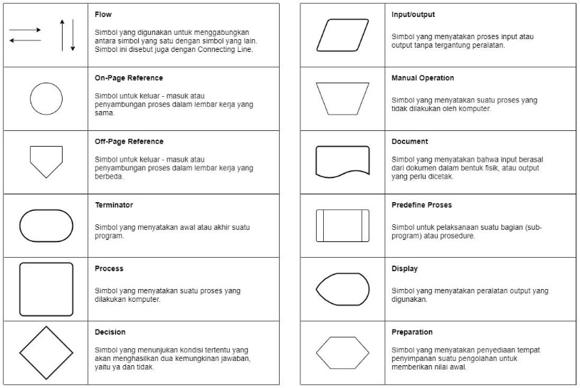
Simbol Flowchart

Slide 23
Tipe Data
Jenis Data. di pyhton=String, Integer, Float, Boolean, dll

Slide 24
Tipe Data yang Umum Digunakan
1.TIPE DATA INTEGER
Tipe integer menyatakan nilai berupa bilangan bulat
(tanpa koma).
Contoh: 10, -5, 2025
2.TIPE DATA FLOAT
Tipe float menyatakan nilai berupa bilangan desimal (ada
koma).
Contoh: 3.14, -2.5, 0.001
3.TIPE DATA STRING
Tipe string menyatakan teks, ditulis di antara tanda kutip
" " atau ' '.
Contoh: "Hello",'Python'
4.TIPE DATA BOOLEAN
Tipe boolean hanya bernilai True atau False.
Contoh: True, False
5.TIPE DATA LIST
Tipe list menyimpan kumpulan data yang bisa diubah
(mutable).
Contoh: [1, 2, 3], ["a","b","c"]
6.TIPE DATA TUPLE
Tipe tuple mirip list, tapi isinya tidak bisa diubah
(immutable).
Contoh: (1, 2, 3)
7.TIPE DATA DICTIONARY
Tipe dictionary menyimpan data dalam bentuk pasangan
key → value.
Contoh: {"nama": “asal","usia": 17}
8.TIPE DATA SET
Tipe set menyimpan kumpulan data unik (tidak boleh ada
duplikat).
Contoh: {1, 2, 3, 4}

Slide 25
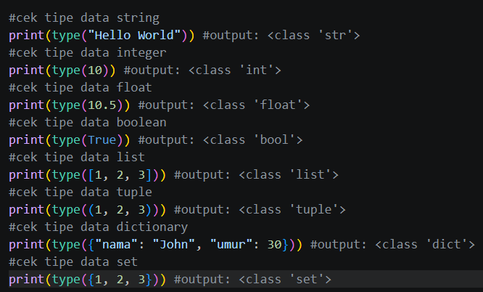
Cek Tipe Data
Menggunakan Fungsi type()

Slide 26
Oprasi
Memanipulasi data

Slide 27
Variabel
Algoritma
Pemrograman
Otak atau logika di balik sebuah program, tanpa algoritma program yang dibuat akan tidak efisien, salah, atau nahkan tidak bisa berjalan
proses menerjemahkan algoritma tersebut ke dalam bahasa yang dapat dipahami dan dijalankan oleh computer. Tanpa pemrograman, algoritma akan menjadi konsep di atas kertas

Slide 28

Tools/Shoftware

Slide 29
Technology Infographics
Jupiter
Jupiter is the biggest planet in the Solar System
Mars
Despite being red, Mars is actually a cold place
Neptune
Neptune is the farthest planet from the Sun

Slide 30
Technology Infographics
Saturn
It’s a gas giant and has several rings
Jupiter
Jupiter is the biggest planet of them
Neptune
It’s the farthest planet from the Sun
Mars
Despite being red, Mars is cold
Mercury
It’s the closest planet from the Sun
Earth
Earth is the third planet from the Sun

Slide 31
Technology Infographics
Mars
Jupiter
Despite being red, Mars is actually cold
25%
35%
Jupiter is the biggest planet of them all
Earth
Neptune
Earth is the third planet from the Sun
10%
40%
Neptune is the farthest planet from the Sun

Slide 32
01
Saturn is a gas giant and has several rings
Technology Infographics
02
Despite being red, this planet is actually a cold place
03
Mercury is the closest planet from the Sun
04
Neptune is the farthest planet from the Sun

Slide 33
Technology Infographics
Jupiter
Saturn
Jupiter is the biggest planet of them all
03
04
It’s a gas giant and has several rings
Mars
02
05
Neptune
Despite being red, Mars is actually cold
It’s the farthest planet from the Sun
Earth
01
06
Mercury
Earth is the third planet from the Sun
It’s the closest planet from the Sun

Slide 34
1
Jupiter
Jupiter is the biggest planet of them all
4
Neptune
Technology Infographics
Neptune is the farthest planet from the Sun
2
Mars
Despite being red, Mars is actually cold
5
Earth
Earth is the third planet from the Sun
3
Saturn
Saturn is a gas giant and has several rings

Slide 35
Technology Infographics
1
6
Jupiter
Saturn
Jupiter is the biggest planet of them all
It’s a gas giant and has several rings
2
5
Mars
Neptune
Despite being red, Mars is actually cold
It’s the farthest planet from the Sun
3
4
Earth
Mercury
Earth is the third planet from the Sun
It’s the closest planet to the Sun

Slide 36
Technology Infographics
Jupiter
Mercury
Jupiter is the biggest planet
It’s the closest planet of the Sun
Neptune
Earth
It’s the farthest planet from the Sun
It’s the third planet from the Sun
Saturn
Mars
It’s a gas giant and has several rings
Despite being red, it’s a cold place

Slide 37
Technology Infographics
Jupiter
Mercury
Jupiter is the biggest planet of them all
It’s the closest planet of the Sun
Neptune
Earth
It’s the farthest planet from the Sun
It’s the third planet from the Sun
Saturn
Mars
It’s a gas giant and has several rings
It’s actually a cold place

Slide 38
Technology Infographics
Jupiter is the biggest planet of all the solar system
Despite being red, Mars is actually a really cold place
Jupiter
Mars
Saturn
Saturn is a gas giant and has several ring around it
Venus
Earth
Venus is the second planet from the Sun and has a beautiful name
It’s the third planet from the Sun and the only known to harbor life

Slide 39
Technology Infographics
Jupiter
Mercury
Jupiter is the biggest planet of them all
It’s the closest planet of the Sun
Neptune
Earth
It’s the farthest planet from the Sun
It’s the third planet from the Sun
Saturn
Mars
It’s a gas giant and has several rings
It’s actually a cold place

Slide 40
Technology Infographics
Jupiter
Earth
Jupiter is the biggest planet
Earth is where we live on
Mars
Neptune
Despite being red, it’s cold
It’s far away from Earth
Saturn
Venus
It has several rings
It has a beautiful name

Slide 41
Technology Infographics
Neptune
Earth
It’s the farthest planet from the Sun
It’s the third planet from the Sun
Jupiter
Mercury
Jupiter is the biggest planet of them all
It’s the closest planet of the Sun

Slide 42
Technology Infographics
Mercury
It’s the closest planet of the Sun
Earth
It’s the third planet from the Sun
Mars
Despite being red, Mars is a cold place

Slide 43
Technology Infographics
Jupiter
Jupiter is the biggest planet of them all
Earth
2
4
It’s the third planet from the Sun
Neptune
It’s the farthest planet from the Sun
1
3
5
Mars
It’s actually a cold place
Saturn
It’s a gas giant and has several rings

Slide 44
Technology Infographics
Jupiter
Mercury
Jupiter is the biggest planet of them all
It’s the closest planet of the Sun
Neptune
Earth
It’s the farthest planet from the Sun
It’s the third planet from the Sun
Saturn
Mars
It’s a gas giant and has several rings
It’s actually a cold place

Slide 45
Technology Infographics
Jupiter
Mercury
Jupiter is the biggest planet of them all
It’s the closest planet of the Sun
Neptune
Earth
It’s the farthest planet from the Sun
It’s the third planet from the Sun
Saturn
Mars
It’s a gas giant and has several rings
It’s actually a cold place

Slide 46
Technology Infographics
Neptune
Venus
It’s the farthest planet from the Sun
It’s the closest planet of the Sun
Jupiter
Earth
Mars
Jupiter is the biggest planet of them all
It’s the third planet from the Sun
Despite being red, it’s actually a cold place

Slide 47
Technology Infographics
Neptune
It’s the farthest planet from the Sun
Jupiter
Earth
Jupiter is the biggest planet of them all
It’s the third planet from the Sun
Mars
Mercury
Despite being red, it’s actually a cold place
It’s the closest planet from the Sun

Slide 48
Technology Infographics
1
3
5
Jupiter is the biggest planet of them all
Saturn is a gas giant and has several rings
Mercury is the closest planet of the Sun
2
4
6
Neptune is the farthest planet from the Sun
Earth is the third planet from the Sun
Despite being red, it’s actually a cold place

Slide 49
Technology Infographics
1
Jupiter
Jupiter is the biggest planet of them all
2
Mars
Despite being red, it’s actually a cold place
3
Saturn
Saturn is a gas giant and has several rings
4
Mercury
Mercury is the closest planet to the Sun
5
Neptune
Neptune is the farthest from the Sun

Slide 50
Technology Infographics
Jupiter
Neptune
Saturn
Mars
Mercury
Earth
Jupiter is the biggest planet
Neptune is the farthest planet
Saturn has several rings
Mars is actually a cold place
It’s the closest planet of the Sun
Earth is the third planet to the Sun

Slide 51
Technology Infographics
Jupiter
Saturn
Jupiter is the biggest planet of them all
It’s a gas giant and has several rings
Neptune
Mercury
It’s the farthest planet from the Sun
It’s the closest planet of the Sun

Slide 52
Technology Infographics
Mercury
It’s the closest planet of the Sun
Jupiter
Neptune
Jupiter is the biggest planet of them all
It’s the farthest planet from the Sun
Saturn
Mars
It’s a gas giant and has several rings
It’s actually a cold place
Earth
It’s the third planet from the Sun

Slide 53
Technology Infographics
Jupiter
Mercury
Jupiter is the biggest planet of them all
It’s the closest planet of the Sun
Neptune
Earth
It’s the farthest planet from the Sun
It’s the third planet from the Sun
Saturn
Mars
It’s a gas giant and has several rings
Despite being red, it’s actually a cold place

Slide 54
Technology Infographics
Jupiter
Saturn
Jupiter is the biggest planet
Saturn has several rings
Mars
Earth
Mars is actually a cold place
Earth is the the third planet
Neptune
Mercury
Neptune is the farthest planet
Mercury is the smallest planet

Slide 55
Instructions for use
In order to use this template, you must credit Slidesgo and Freepik in your final presentation and include links to both websites.
You are allowed to:
- Modify this template.
- Use it for both personal and commercial projects.
You are not allowed to:
- Sublicense, sell or rent any of Slidesgo Content (or a modified version of Slidesgo Content).
- Distribute Slidesgo Content unless it has been expressly authorized by Slidesgo.
- Include Slidesgo Content in an online or offline database or file.
- Offer Slidesgo templates (or modified versions of Slidesgo templates) for download.
- Acquire the copyright of Slidesgo Content.
For more information about editing slides, please read our FAQs or visit Slidesgo School:
https://slidesgo.com/faqs and https://slidesgo.com/slidesgo-school

Slide 56
Infographics
You can add and edit some infographics to your presentation to present your data in a visual way.
Choose your favourite infographic and insert it in your presentation using Ctrl C + Ctrl V or Cmd C + Cmd V in Mac.
Select one of the parts and ungroup it by right-clicking and choosing “Ungroup”.
Change the color by clicking on the paint bucket.
Then resize the element by clicking and dragging one of the square-shaped points of its bounding box (the cursor should look like a double-headed arrow). Remember to hold Shift while dragging to keep the proportions.
Group the elements again by selecting them, right-clicking and choosing “Group”.
Repeat the steps above with the other parts and when you’re done editing, copy the end result and paste it into your presentation.
Remember to choose the “Keep source formatting” option so that it keeps the design. For more info, please visit Slidesgo School.

